Slide 1
Data Perikanan Mawasangka
Total landings
CPUE
Size Structure

Slide 2
Total Landings in MAR Mawasangka
60
Decreased
40
Total landings(kg)
20
0
Aug 2019
Feb 2020
Aug 2020
Feb 2021
Aug 2021
Feb 2022
Aug 2022
Feb 2023
Aug 2023
Feb 2024
Aug 2024
Feb 2025
Aug 2025
Feb 2026

Slide 3
Catch Per Unit Effort in MAR Mawasangka
16
Increased
12
CPUE (kg/fisher/trip)
8
4
0
Aug 2019
Feb 2020
Aug 2020
Feb 2021
Aug 2021
Feb 2022
Aug 2022
Feb 2023
Aug 2023
Feb 2024
Aug 2024
Feb 2025
Aug 2025
Feb 2026

Slide 4
Kerapu
Epinephelus coioides

Slide 5
Total Landings E.coioides in MAR Mawasangka
20
Stable
Total landings(kg)
10
0
Sep 2019
Mar 2020
Sep 2020
Mar 2021
Sep 2021
Mar 2022
Sep 2022
Mar 2023
Sep 2023
Mar 2024
Sep 2024
Mar 2025

Slide 6
Catch Per Unit Effort E.coioides in MAR Mawasangka
15
10
Stable
CPUE (kg/fisher/trip)
5
0
Sep 2019
Mar 2020
Sep 2020
Mar 2021
Sep 2021
Mar 2022
Sep 2022
Mar 2023
Sep 2023
Mar 2024
Sep 2024
Mar 2025

Slide 7
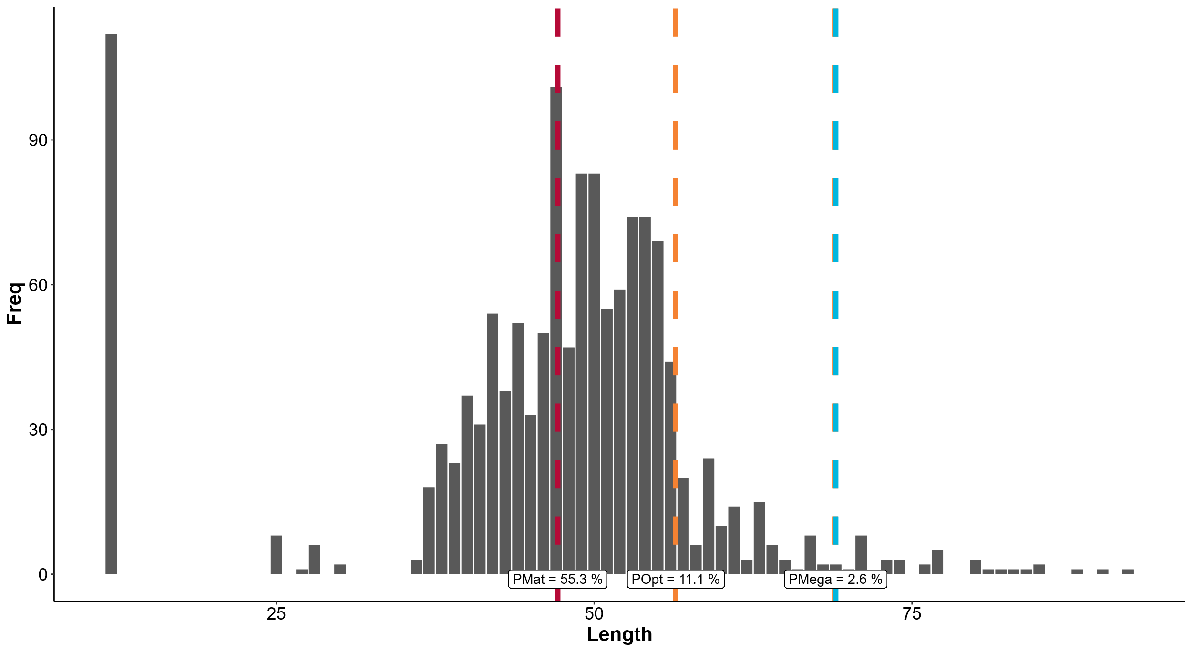

Slide 8
Kakap Merah
Lutjanus malabaricus

Slide 9
Total Landings L.malabaricus in MAR Mawasangka
20
Stable
15
Total landings(kg)
10
5
0
Sep 2019
Mar 2020
Sep 2020
Mar 2021
Sep 2021
Mar 2022
Sep 2022
Mar 2023
Sep 2023
Mar 2024
Sep 2024

Slide 10
Catch Per Unit Effort L.malabaricus in MAR Mawasangka
Stable
6
4
CPUE (kg/fisher/trip)
2
0
Sep 2019
Mar 2020
Sep 2020
Mar 2021
Sep 2021
Mar 2022
Sep 2022
Mar 2023
Sep 2023
Mar 2024
Sep 2024

Slide 11
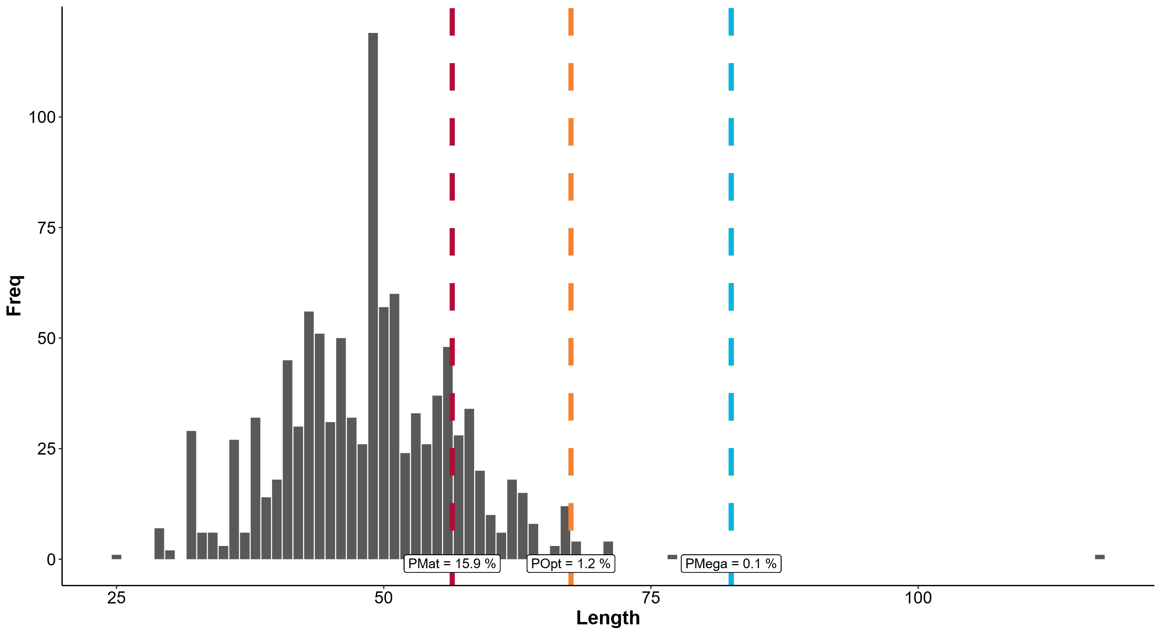

Slide 12
Gurita
Octopus vulgaris

Slide 13
Total Landings O.cyanea in MAR Mawasangka
20
Stable
15
Total landings(kg)
10
5
0
Aug 2019
Feb 2020
Aug 2020
Feb 2021
Aug 2021
Feb 2022
Aug 2022
Feb 2023
Aug 2023
Feb 2024
Aug 2024
Feb 2025
Aug 2025

Slide 14
Catch Per Unit Effort O.cyanea in MAR Mawasangka
10
CPUE (kg/fisher/trip)
Decreased
5
0
Aug 2019
Feb 2020
Aug 2020
Feb 2021
Aug 2021
Feb 2022
Aug 2022
Feb 2023
Aug 2023
Feb 2024
Aug 2024
Feb 2025
Aug 2025

Slide 15
